Slide 1
Preliminary Analysis
Step 1: Data Cleaning and Exploration
Load the Excel data into Python.
Removed “U” value from Gender
Check for missing values and outliers in the "Length of Stay" column which produced none.
Calculate basic statistics like mean, median, and standard deviation of the length of stay.
Create visualisations to show the distribution of length of stay.
Step 2: Segment and Group the data
Segment the data based on different attributes like "Age Group," "Gender," "Race," "Type of Admission," and "Patient Disposition."
Calculate average length of stay for each segment.
Create visualisations like bar charts or box plots to compare the average length of stay across different segments.
Step 3: Insights
Based on the segment analysis, identify any trends or patterns in the data. For example, do certain age groups or admission types have longer stays on average?
Explore the impact of patient disposition on length of stay. Are there certain dispositions that tend to result in longer stays?
Conclusion:
Further investigation to understand the underlying factors that contribute to the variance in length of stays.
An evaluation of other variables such as medical complexity, treatment protocols, and socioeconomic factors to gain deeper insights into the variations in length of stay.

Slide 2
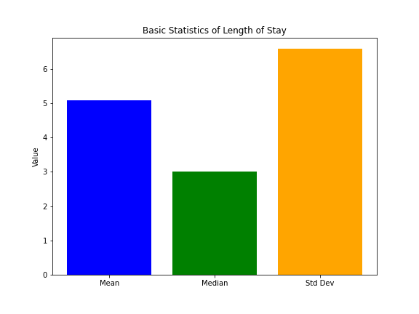
The average length of stay across all patient dispositions was found to be 5.08909 days
Mean is 5.08909 (average)
Median is 3 (“middle” value)
Std Dev is 6.57863 (variation in relation to the mean)

Slide 3
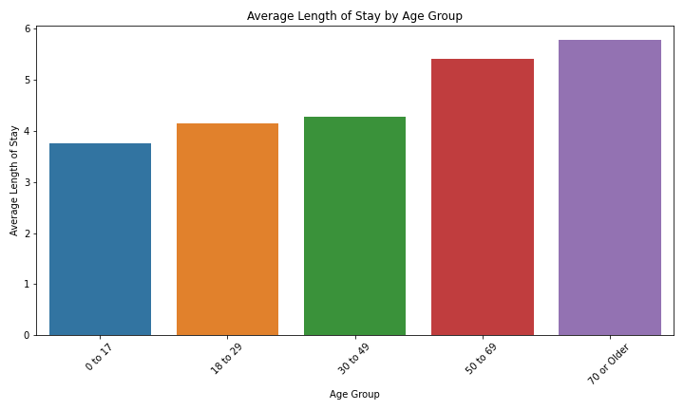
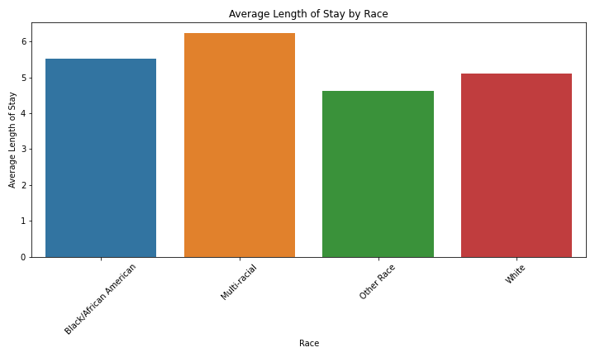
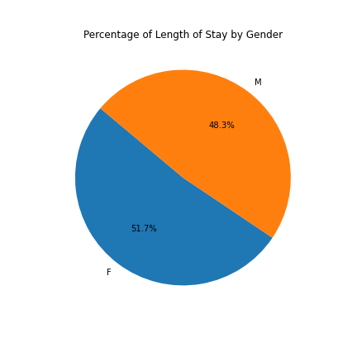
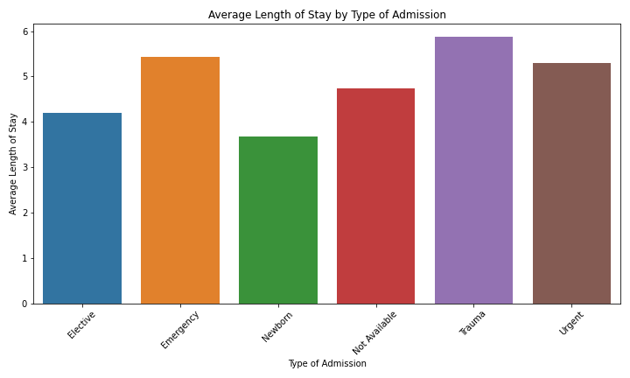
Segment Analysis: Age Group: The analysis revealed that 50+ age group had the longest average length of stay, while 0 to 17 had the shortest. Gender: Gender did not appear to be a significant factor in determining length of stay, as percentages were similar between male and female patients. Race: The length of stay varied slightly between different racial groups, with the multi-racial group having a somewhat longer stay on average. Type of Admission: Emergency and Trauma patients tended to have a slightly longer average length of stay compared to other admission types. However, the admissions with unavailable data make up a large proportion of the statistics and could be researched further for accuracy. Patient Disposition: Notably, patients with Federal Health Care Facility destination or status upon discharge, tended to have a longer length of stay, suggesting a potential correlation between this disposition and extended hospitalisation

Slide 4
